Slide 1
Hashing
Hashing
National University of
Computer & Emerging Sciences

Slide 2
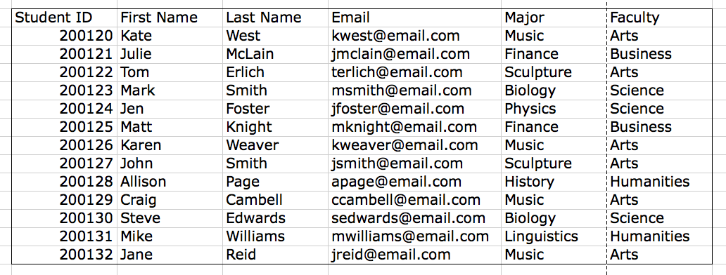
What is a database?
Hashing
Structured collection of data.

Slide 3
The Dictionary ADT
Hashing
a dictionary (table) is an abstract model of a database
a dictionary stores key-element pairs
the main operation supported by a dictionary is searching by key

Slide 4
Examples
Hashing
Telephone directory
Library catalogue
Books in print: key ISBN
Any other example?

Slide 5
Applications
Hashing
Keeping track of customer account information at a bank
  Search through records to check balances and perform transactions
Keep track of reservations on flights
  Search to find empty seats, cancel/modify reservations
Search engine
  Looks for all documents containing a given word

Slide 6
Main Issues
Hashing
Size
Operations: search, insert, delete
What will be stored in the dictionary?
How will be items identified?

Slide 7
The Dictionary ADT
Hashing
simple container methods:
  size()
  isEmpty()
  elements()
query methods:
  findElement(k)
  findAllElements(k)

Slide 8
The Dictionary ADT
Hashing
update methods:
  insertItem(k, e)
  removeElement(k)
  removeAllElements(k)

Slide 9
Implementing a Dictionary
Hashing
unordered sequence
  searching and removing takes O(n) linear time
  inserting takes O(1) constant time
  applications to log files (frequent insertions, rare searches and removals) 34 14 12 22 18
34
14
12
22
18

Slide 10
Implementing a Dictionary
Hashing
array-based ordered sequence
(assumes keys can be ordered)
- searching takes O(log n) time (binary search)
- inserting and removing takes O(n) time
- application to look-up tables
(frequent searches, rare insertions and removals)
12
14
18
22
34

Slide 11
A case scenario
Hashing
Relenor is a large phone company, and they want to provide enhanced caller ID capability:
  given a phone number, return the caller’s name
  phone numbers are in the range 0 to R = 10¹⁰–1
  n is the number of phone numbers used
  want to do this as efficiently as possible

Slide 12
A case scenario
Hashing
We know two ways to design this dictionary:
A balanced search tree (AVL, red-black) has O(log n) query time and O(n) space --- good space usage and search time, but can we reduce the search time to constant?
Direct Addressing
<number>/51

Slide 13
Direct Addressing
Hashing
Assumptions:
  Key values are distinct
  Each key is drawn from a universe U = {0, 1, . . . , m - 1}
Idea:
  Store the items in an array, indexed by keys
Direct-address table representation:
  An array T[0 . . . m - 1]
  Each slot, or position, in T corresponds to a key in U
  For an element x with key k, a pointer to x (or x itself) will be placed in location T[k]
  If there are no elements with key k in the set, T[k] is empty, represented by NIL

Slide 14
Direct Addressing
Hashing
Each cell is thought of as a bucket or a container
  Holds key element pairs
  In array A of size N, an element e with key k is inserted in A[k].
(null)
(null)
…
Hammad
…
(null)
000-000-0000 000-000-0001 401-863-7639 ... 999-999-9999
<number>/51

Slide 15





Direct Address Table
Hashing
r
Key
Satellite Data
U
(Universe of Keys)
4
0
6
9
7
1
K
(Actual
Keys)
2
3
5
8

Slide 16
Operations
Hashing
Alg.: DIRECT-ADDRESS-SEARCH(T, k)
return T[k]
Alg.: DIRECT-ADDRESS-INSERT(T, x)
T[key[x]] ← x
Alg.: DIRECT-ADDRESS-DELETE(T, x)
T[key[x]] ← NIL
Running time for these operations: O(1)

Slide 17
Advantages with Direct Addressing
Hashing
Direct Addressing is the most efficient way to access the data since
  It takes only single step for any operation on direct address table.
  It works well when the Universe U of keys is reasonable small.

Slide 18
Difficulty with Direct Addressing
Hashing
When the universe U is very large…
Storing a table T of size U may be impractical, given the memory available on a typical computer.
The set K of the keys actually stored may be so small relative to U that most of the space allocated for T would be wasted.

Slide 19
An Example
Hashing
A table, 50 students in a class.
The key, 9 digit SSN, used to identify each student.
Number of different 9 digit number=10⁹
The fraction of actual keys needed. 50/10⁹, 0.000005%
Percent of the memory allocated for table wasted, 99.999995%

Slide 20
Hashing
Hashing
Suppose we were to come up with a “magic function” that, given a value to search for, would tell us exactly where in the array to look
  If it’s in that location, it’s in the array
  If it’s not in that location, it’s not in the array
This function would have no other purpose
This function is called a hash function because it “makes hash” of its inputs

Slide 21
Hashing
Hashing
Huge universe U
Hash function h
0
1
m-1
Hash table

Slide 22
Example (ideal) hash function
Hashing
Suppose our hash function gave us the following values:
  hashCode("apple") = 5
  hashCode("watermelon") = 3
  hashCode("grapes") = 8
  hashCode("cantaloupe") = 7
  hashCode("kiwi") = 0
  hashCode("strawberry") = 9
  hashCode("mango") = 6
  hashCode("banana") = 2
0
1
2
3
4
5
6
7
8
9
kiwi
banana
watermelon
apple
mango
cantaloupe
grapes
strawberry

Slide 23
Finding the hash function
Hashing
How can we come up with this magic function?
In general, we cannot--there is no such magic function ☹
  In a few specific cases, where all the possible values are known in advance, it has been possible to compute a perfect hash function
What is the next best thing?
  A perfect hash function would tell us exactly where to look
  In general, the best we can do is a function that tells us where to start looking!

Slide 24
Example imperfect hash function
Hashing
Suppose our hash function gave us the following values:
  hash("apple") = 5
  hash("watermelon") = 3
  hash("grapes") = 8
  hash("cantaloupe") = 7
  hash("kiwi") = 0
  hash("strawberry") = 9
  hash("mango") = 6
  hash("banana") = 2
  hash("honeydew") = 6
0
1
2
3
4
5
6
7
8
9
kiwi
banana
watermelon
apple
mango
cantaloupe
grapes
strawberry
• Now what?

Slide 25
Collisions
Hashing
When two values hash to the same array location, this is called a collision
Collisions are normally treated as “first come, first served”—the first value that hashes to the location gets it
We have to find something to do with the second and subsequent values that hash to this same location

Slide 26
Hashing
Hashing
Huge universe U
Hash function h
Collisions
0
1
m-1
Hash table

Slide 27
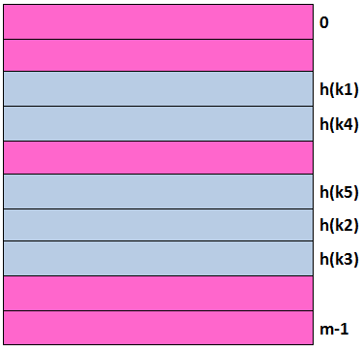


Hash Table: Idea
Hashing
r
U
(Universe of Keys)
K
(Actual
Keys)
K1
K4
K5
K2
K3

Slide 28
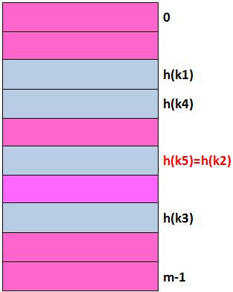

Hash Table: Collision
Hashing
Collision: Two or more keys hash to the same slot
r
U
(Universe of Keys)
K
(Actual
Keys)
K1
K4
K5
K2
K3

Slide 29
Compared to direct addressing
Hashing
Advantage: Requires less storage and runs in O(1) time.
Comparison
 | Storage Space | Storing k
Direct Addressing | |U| | Store in slot k
Hashing | m | Store in slot h(k)

Slide 30
Handling collisions
Hashing
What can we do when two different values attempt to occupy the same place in an array?
  Solution #1: Search from there for an empty location
    Can stop searching when we find the value or an empty location
    Search must be end-around
  Solution #2: Use a second hash function
    ...and a third, and a fourth, and a fifth, ...
  Solution #3: Use the array location as the header of a linked list of values that hash to this location
All these solutions work, provided:
  We use the same technique to add things to the array as we use to search for things in the array

Slide 31
Insertion, I
Hashing
Suppose you want to add seagull to this hash table
Also suppose:
  hashCode(seagull) = 143
  table[143] is not empty
  table[143] != seagull
  table[144] is not empty
  table[144] != seagull
  table[145] is empty
Therefore, put seagull at location 145
. . .
141
142
143
144
145
146
147
148
. . .
robin
sparrow
hawk
seagull
bluejay
owl

Slide 32
Searching, I
Hashing
Suppose you want to look up seagull in this hash table
Also suppose:
  hashCode(seagull) = 143
  table[143] is not empty
  table[143] != seagull
  table[144] is not empty
  table[144] != seagull
  table[145] is not empty
  table[145] == seagull !
We found seagull at location 145
. . .
141
142
143
144
145
146
147
148
. . .
robin
sparrow
hawk
seagull
bluejay
owl

Slide 33
Searching, II
Hashing
Suppose you want to look up cow in this hash table
Also suppose:
  hashCode(cow) = 144
  table[144] is not empty
  table[144] != cow
  table[145] is not empty
  table[145] != cow
  table[146] is empty
If cow were in the table, we should have found it by now
Therefore, it isn’t here
. . .
141
142
143
144
145
146
147
148
. . .
robin
sparrow
hawk
seagull
bluejay
owl

Slide 34
Insertion, II
Hashing
Suppose you want to add hawk to this hash table
Also suppose
  hashCode(hawk) = 143
  table[143] is not empty
  table[143] != hawk
  table[144] is not empty
  table[144] == hawk
hawk is already in the table, so do nothing
. . .
141
142
143
144
145
146
147
148
. . .
robin
sparrow
hawk
seagull
bluejay
owl

Slide 35
Insertion, III
Hashing
Suppose:
  You want to add cardinal to this hash table
  hashCode(cardinal) = 147
  The last location is 148
  147 and 148 are occupied
Solution:
  Treat the table as circular; after 148 comes 0
  Hence, cardinal goes in location 0 (or 1, or 2, or ...)
. . .
141
142
143
144
145
146
147
148
robin
sparrow
hawk
seagull
bluejay
owl

Slide 36
Clustering
Hashing
One problem with the above technique is the tendency to form “clusters”
A cluster is a group of items not containing any open slots
The bigger a cluster gets, the more likely it is that new values will hash into the cluster, and make it ever bigger
Clusters cause efficiency to degrade
Here is a non-solution: instead of stepping one ahead, step n locations ahead
  The clusters are still there, they’re just harder to see
  some table locations may be never checked

Slide 37
Solution #2: Rehashing
Hashing
In the event of a collision, another approach is to rehash: compute another hash function
  Since we may need to rehash many times, we need an easily computable sequence of functions

Slide 38
Solution #2: Rehashing
Hashing
Simple example: in the case of hashing Strings, we might take the previous hash code and add the length of the String to it
  Probably better if the length of the string was not a component in computing the original hash function
Possibly better yet: add the length of the String plus the number of probes made so far
  Problem: are we sure we will look at every location in the array?
Rehashing is a fairly uncommon approach, and we won’t pursue it any further here

Slide 39
Solution #3: Chaining
Hashing
The previous solutions used open address hashing: all entries went into a “flat” (unstructured) array
Another solution is to make each array location the header of a linked list of values that hash to that location
. . .
141
142
143
144
145
146
147
148
. . .
robin
sparrow
seagull
hawk
bluejay
owl

Slide 40
Chaining
Hashing
0
1
2
3
4
<number>/51

Slide 41








Collision By Chaining
Hashing
r
U
(Universe of Keys)
K
(Actual
Keys)
K1
K4
K5
K7
K2
K8
K3
K6

Slide 42
What is a Hash function?
Hashing
A hash function is a mapping between a set of input values (Keys) and a set of integers, known as hash values.
Choosing a good hash-function is crucial !!
Hash
function
Keys
Hash values

Slide 43
The properties of a good hash function
Hashing
Rule1: The hash value is fully determined by the data being hashed.
Rule2: The hash function uses all the input data.
Rule3: The hash function uniformly distributes the data across the entire set of possible hash values.
Rule4: The hash function generates very different hash values for similar strings.

Slide 44
An example of a hash function
Hashing
int hash(char *str, int table_size)
{
int sum=0;
//sum up all the characters in the string
for(;*str; str++)
sum+=*str
//return sum mod table_size
return sum%table_size;
}

Slide 45
Analysis of example
Hashing
Rule1: Satisfies, the hash value is fully determined by the data being hashed, the hash value is just the sum of all input characters.
Rule2: Satisfies, Every character is summed.

Slide 46
Analysis of example (contd.)
Hashing
Rule3: Breaks, from looking at it, it is not obvious that it doesn’t uniformly distribute the strings, but if you were to analyze this function for larger input string, you will see certain statistical properties which are bad for a hash function.
Rule4: Breaks, hash the string “CAT”, now hash the string “ACT”, they are the same, a slight variation in the string should result in different hash values, but with this function often they don’t.

Slide 47
Methods to create hash functions
Hashing
Division method
Multiplication method

Slide 48
Division method
Hashing
The division method requires two steps.
  The key must be transformed into an integer.
  The value must be telescoped into range 0 to m-1

Slide 49
Division method…
Hashing
We map a key k into one of the m slots by taking the remainder of k divided by m, so the hash function is of form
h(k)= k mod m
For example , if m=12, key is 100 then h(k)=100 mod 12= 4.
Advantage?

Slide 50
The Division Method
Hashing
Advantage:
  fast, requires only one operation
Disadvantage:
  Certain values of m are bad (i.e., collisions), e.g.,
    power of 2
    non-prime numbers

Slide 51
Division Method - Example
Hashing
If m = 2^{p}, then h(k) = k mod 2^{p} just the least significant p bits of k
  p = 1 ⇒ m = 2
  ⇒ h(k) = {0, 1) , select least significant 1 bit of k
  p = 2 ⇒ m = 4
  h(k) = {0,1,2,3}, select least significant 2 bits of k
k mod 2⁸ selects these bits
0110010111000011010

Slide 52
Division Method - Example
Hashing
  All combinations are not generally equally likely
  Prime numbers not close to 2^{n} seem to be good choices
  eg want ~4000 entry table, choose m = 4093 (2¹² = 4096)
k mod 2⁸ selects these bits
0110010111000011010

Slide 53
Restrictions on value of m
Hashing
M should not be a power of 2, since if m=2^{p} then h(k) is just the p lowest order bits of k.
Disadvantage!
Key | Binary | K mod 8
8 | 1000 | 0
7 | 111 | 7
12 | 1100 | 4
34 | 100010 | 2
56 | 111000 | 0
78 | 1001110 | 6
90 | 1011010 | 2
23 | 10111 | 7
45 | 101101 | 5
67 | 1000011 | 3

Slide 54
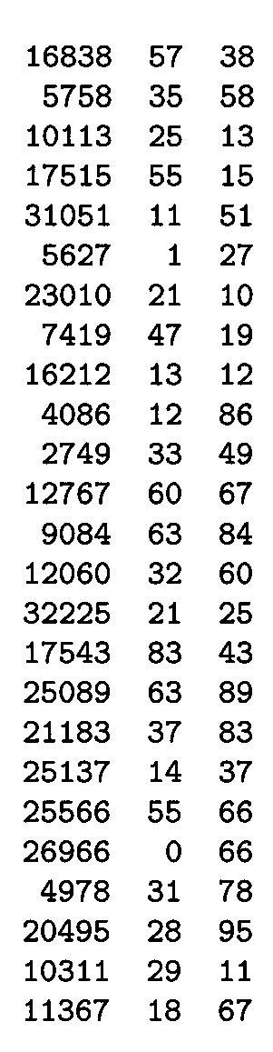
Division Method - Example
Hashing
m97
m
100
Power of 10 should be avoided, if application deals with decimal numbers as keys.
Choose m to be a prime,
  Column 2: k mod 97 (Prime)
  Column 3: k mod 100 (non- prime)
Good values of m are primes not close to the exact powers of 2 (or 10).

Slide 55
Restrictions on value of m
Hashing
Unless it is known that probability distribution on keys makes all lower order p-bit patterns equally likely,
It is better to make the hash function dependent on all the bits of the key.

Slide 56

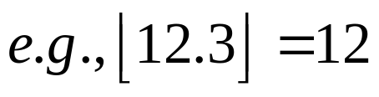
The Multiplication Method
Hashing
Idea:
(1) Multiply key k by a constant A, where 0 < A < 1
(2) Extract the fractional part of kA
(3) Multiply the fractional part by m (hash table size)
(4) Truncate the result to get result in the range 0 ..m-1
h(k) = = ⎣m (k A mod 1)⎦
Disadvantage: Slower than division method
Advantage: Value of m is not critical
fractional part of kA = kA - ⎣kA⎦

Slide 57
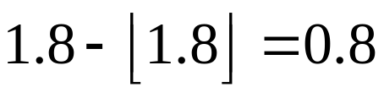
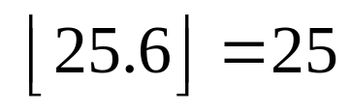
Multiplication Method – Example 1
Hashing
Suppose k=6 , A=0.3, m=32
(1) k x A = 1.8
(2) fractional part:
(3) m x 0.8 = 32 x 0.8 = 25.6
(4)
h(6)=25

Slide 58
More on multiplication method
Hashing
Choose m = 2^{P}
For a constant A, 0 < A < 1:
h(k) = ⎣ m (kA - ⎣kA⎦) ⎦
Value of A should not be close to 0 or 1
Knuth says good value of A is 0.618033
If k=123456, m=10000,and A as above
h(k)= ⎣10000*(123456*A- ⎣123456*A⎦)
= ⎣10000*0.0041151⎦
=41

Slide 59
Hashing with Open Addressing
Hashing
So far we have studied hashing with chaining, using a linked-list to store keys that hash to the same location.
Maintaining linked lists involves using pointers which is complex and inefficient in both storage and time requirements.
Another option is to store all the keys directly in the table. This is known as open addressing, where collisions are resolved by systematically examining other table indexes, i ₀ , i ₁ , i ₂ , … until an empty slot is located.

Slide 60
Open addressing
Hashing
  Another approach for collision resolution.
  All elements are stored in the hash table itself (so no pointers involved as in chaining).
  To insert: if slot is full, try another slot, and another, until an open slot is found (probing)
  To search: follow same sequence of probes as would be used when inserting the element

Slide 61


Open Addressing
Hashing
The key is first mapped to a slot:
If there is a collision subsequent probes are performed:
If the offset constant, c and m are not relatively prime, we will not examine all the cells. Ex.:
  Consider m=4 and c=2, then only every other slot is checked.
  When c=1 the collision resolution is done as a linear search. This is known as linear probing.
0
1
2
3

Slide 62
Insertion in hash table
Hashing
HASH_INSERT(T,k)
i ← 0
repeat j ← h(k,i)
if T[j] = NIL
then T[j] = k
return j
else i ← i +1
until i = m
error “ hash table overflow”

Slide 63
Searching from Hash table
Hashing
HASH_SEARCH(T,k)
1 i ← 0
2 repeat j ← h(k,i)
3 if T[j] = k
4 then return j
5 i ← i +1
6 until T[j] = NIL or i = m
7 return NIL

Slide 64
Analysis
Hashing
Worst case for inserting a key is θ(n)
Worst case for searching is θ(n)
Algorithm assumes that keys are not deleted once they are inserted
Deleting a key from an open addressing table is difficult, instead we can mark them in the table as removed (introduced a new class of entries, full, empty and removed)

Slide 65
Clustering
Hashing
Even with a good hash function, linear probing has its problems:
  The position of the initial mapping i ₀ of key k is called the home position of k.
  When several insertions map to the same home position, they end up placed contiguously in the table. This collection of keys with the same home position is called a cluster.
  As clusters grow, the probability that a key will map to the middle of a cluster increases, increasing the rate of the cluster’s growth. This tendency of linear probing to place items together is known as primary clustering.
  As these clusters grow, they merge with other clusters forming even bigger clusters which grow even faster.

Slide 66
Quadratic probing
Hashing
  h(k,i) = (h’(k) + c₁i + c₂i ²) mod m for i = 0,1,…,m − 1.
  Leads to a secondary clustering (milder form of clustering)
  The clustering effect can be improved by increasing the order to the probing function (cubic). However the hash function becomes more expensive to compute
  But again for two keys k1 and k2, if h(k1,0)= h(k2,0) implies that h(k1,i)= h(k2,i)

Slide 67
Double Hashing
Hashing
Recall that in open addressing the sequence of probes follows
We can solve the problem of primary clustering in linear probing by having the keys which map to the same home position use differing probe sequences. In other words, the different values for c should be used for different keys.
Double hashing refers to the scheme of using another hash function for c

Slide 68
Reference
Hashing
Chapter #11
  Introduction to Algorithms (3rd Edition)

